Slide 1
Introduction Series
Natural Language Processing
with Microsoft Luis and Spacy

Slide 2
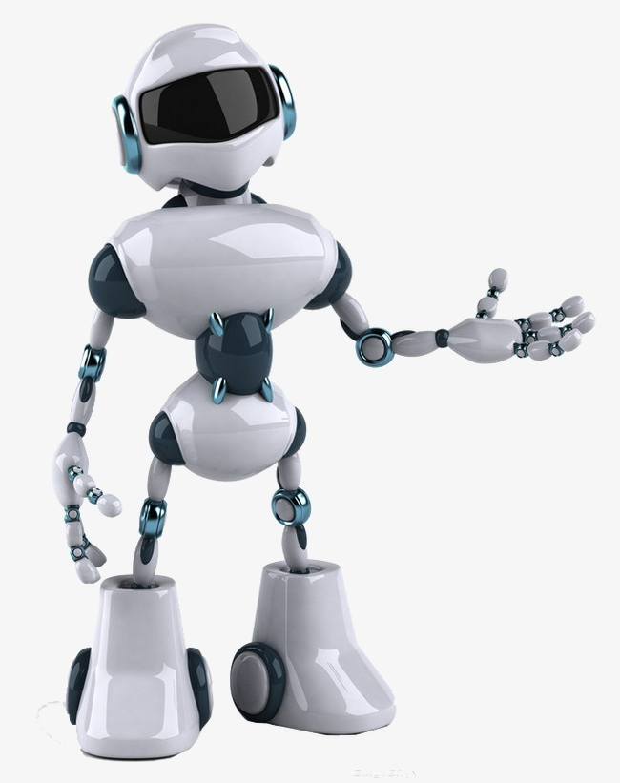

Computers dig Data Structures & Binary Data
00110101000101000101011001010001110101011001110010101110101111

Slide 3

We’re Unstructured!
The Average Adult has a Vocabulary of 20-35,000 Words
The Average Adult Will Learn One New Word a Day Until Middle Age
The Average Native Speaking 4 Year old Will Know 5,000 Words
Native Speaking 8 Year Olds Will Already Known 8,000 Words
Average Foreign Speaker Will Learn 10,000 Words by Living Abroad
The Most Common Vocabulary Size for a Foreign Speaker is 4,500 Words
Foreign Speakers Will Learn 2.5 Words per Day on Average

Slide 4
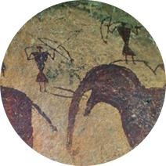
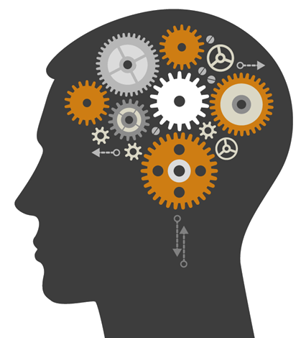


History
Experi-ence
Emotion
Visualise
Real-Life

Slide 5
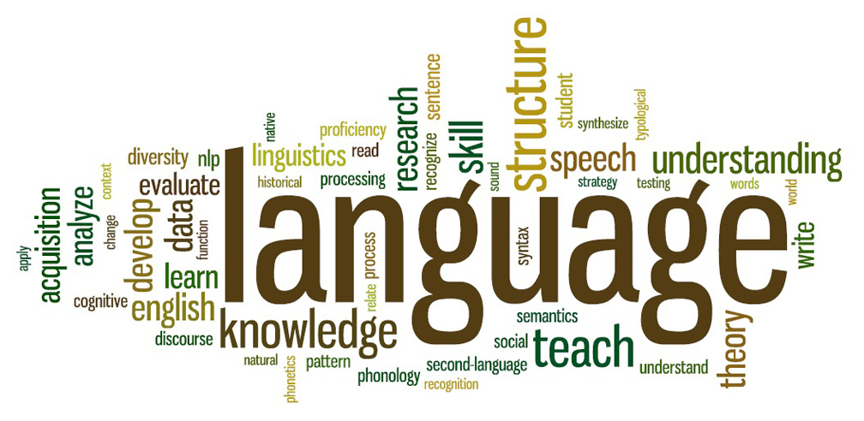
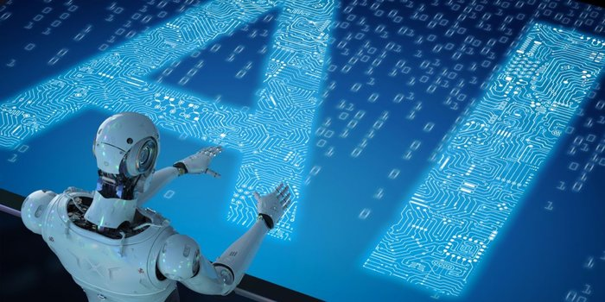
Natural Language Processing (NLP)
Sub-field of Artificial Intelligence
Understand and Process Human Languages and Generate Speech
Enable computers to get close to how Humans use Language
It’s not easy, they do not have Intuition, they cannot understand what the language is trying to say
Deep Learning Advancements – Translation, Summarisation & Semantic Understanding

Slide 6


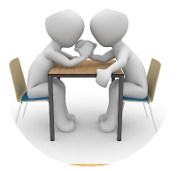
Why is NLP Hard?
Someone was on fire, did anyone call the Fire Brigade?
My team was on fire last night, they absolutely killed the opposition!
Fire
Killed
People died, surely whatever the problem was, it could be been resolved another way?
Opposition

Slide 7
How does it Work?
Natural Language Processing (NLP)
Natural Language Understanding (NLU)
Natural Language Generation (NLG)
Convert
Decompose
Understanding
Translate
Speech
Speech recognition (Hidden Markov Model)
Statistical models to determine what was said
Compare 10-20ms segments
Called “Part-of-Speech Tagging” (POS)
Understand the meaning of each word, is it a noun, verb, past-tense, etc
Lexicon and grammar rules
Statistical Machine Learning (ML)
Challenges with Polysemy and Synonymy
What information to translate?
Results of a query, organised into a structure of what it wants to say
Reverse of NFU, lexicon and grammar rules to author sentence
The engine can now use the nuances of the audience to communicate back to the human
If vocalised, a text-to-speech engine will take over

Slide 8
NLP & Language
Intents
Entities
Model
Utterances
Specific to Chatbots, represents the words that describe the intention of a piece of sentence, for example an action word like “Show”
A real-world-object that is assigned a name, for example a person, a country, a product or a book title
The process of training a Machine Learning (ML) model involves passing training data to a learning algorithm. The model is the output of the training process and is used to get predictions on new data, which you do not know the target
Anything that is said, for example “what hotels are within 3 miles of London Heathrow airport”

Slide 9
Demo

Slide 10

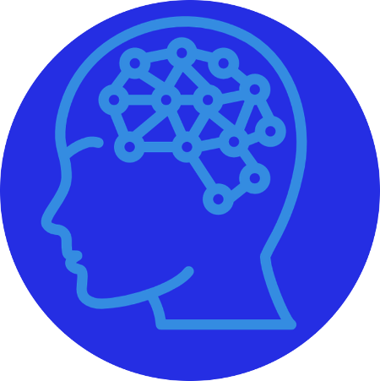

Chatbot Demo: How does it Work?
Natural Language Processing (NLP)
Natural Language Understanding (NLU)
Natural Language Generation (NLG)
Decompose
Understanding
Translate
Speech
Via the emulator, the Chatbot receives the text over HTTP
The Bot sends the text to the NLP engine via a REST endpoint
The text meaning is returned to the Bot where it is translated into a response
The Bot presents the response back to the user

Slide 11
Further Reading
Spacy (Open Source NLP Engine)
https://spacy.io
Microsoft Luis NLP Engine
https://www.luis.ai/home

Slide 12
Thank you

